Slide 1
Monthly Sales Dashboard
────────────────────────────
Sales Performance Analysis
2020 vs. 2021
Prepared by:
Yousef Nasibi
Data Visualization Project

Slide 2
👁Vision:
• Provide actionable insights into monthly sales performance.
📈 Strategy:
• Compare 2020 and 2021, analyze trends, differences, growth and KPIs.
🎯Objectives:
• Compare monthly sales
• Identify trend reversals
• Evaluate yearly growth

Slide 3
Business Questions
?
How did sales change?
?
Which months contributed most?
?
When did trend reverse?
?
What is annual growth?

Slide 4
Month | Year | Year | Difference (2021 - 2020) | Growth
 | 2020 | 2021
January | $38,000 | $99,000 | $61,000 | 161%
February | $47,000 | $78,000 | $31,000 | 66%
March | $49,000 | $90,000 | $41,000 | 84%
April | $42,000 | $77,000 | $35,000 | 83%
May | $42,000 | $78,000 | $36,000 | 86%
June | $38,000 | $71,000 | $33,000 | 87%
July | $43,000 | $78,000 | $35,000 | 81%
August | $52,000 | $62,000 | $10,000 | 19%
September | $49,000 | $68,000 | $19,000 | 39%
October | $67,000 | $50,000 | -$17,000 | -25%
November | $74,000 | $43,000 | -$31,000 | -42%
December | $86,000 | $41,000 | -$45,000 | -52%
total | $627,000 | $835,000 | $208,000 | 33.2%

Slide 5

Trend Reversal
2020
2021
The year 2021 began with a stunning surge, peaking in January with a 161% growth rate. This strong performance continued through the end of September, establishing a comfortable profit margin for the organization.
October served as a turning point, marking the first time the 2021 sales figures fell 25% behind the previous year's levels. This alarm signal intensified in December, when sales plummeted by 52% (a drop of $45,000)—resulting in December 2020 sales figures that were more than double those of December 2021.
Although an unprecedented surge in sales during the first nine months of the year managed to offset the crisis and sharp decline of the fourth quarter (Q4)—keeping full-year growth in positive territory (up 33.2% year-over-year)—this growth model is unsustainable due to extreme vulnerability during the colder seasons, necessitating a serious re-evaluation of the winter sales strategy.

Slide 6
Insight:
• Monthly sales differences remained positive from January through September.
• October marked the first negative year-over-year difference.
• December recorded the largest decline (-$45,000).

Slide 7
🏆
📊
📉
Insight:
• 2021 achieved a higher average monthly sales level than 2020.
• Both the highest and lowest monthly sales values increased, indicating an overall improvement in sales performance.

Slide 8
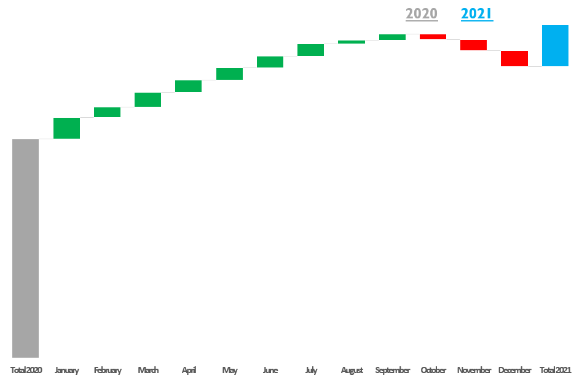
$835K
Insight:
Strong sales gains during the first nine months more than offset the declines in Q4, resulting in a net annual sales increase of $208K (+33.2%).
$19K
$-17K
$61K
$627K
Final Quarter Decline

Slide 9
Executive Summary
① 2021 outperformed 2020 during the first three quarters.
② October marked the trend reversal.
③ Strong gains offset Q4 declines.
④ Net annual sales increased by $208K (+33.2%).

Slide 10
Regional Performance Dashboard
────────────────────────────
Regional Sales Performance Analysis Across Iranian Provinces
Prepared by:
Yousef Nasibi
Data Visualization Project

Slide 11
Business Context:
This dashboard evaluates regional sales performance across selected provinces in Iran. By comparing regional
percentages and identifying top and bottom performers, decision-makers can better understand performance disparities
and prioritize strategic actions.
Business Objectives:
Compare regional sales performance.
Identify top-performing and underperforming provinces.
Evaluate regional distribution patterns.
Support data-driven resource allocation.
Business Questions:
Which province achieved the highest sales performance?
Which provinces performed below the regional average?
How is performance distributed across regions?
Which regions should be prioritized for improvement?

Slide 12
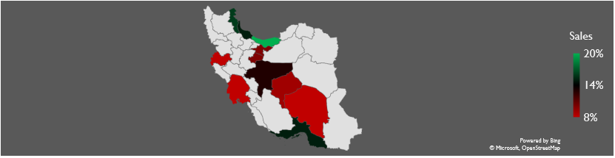
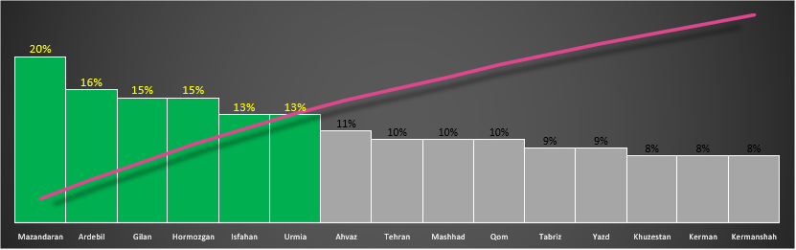
Highest Region
Mazandaran
20%
Average
12%
Lowest Region
Khuzestan,Kerman,Kermanshah
8%
Regional Contribution Analysis
Regional Performance Map
Regions above the average demonstrate stronger performance, while those below the average require attention.
Regional performance ranged from 8% to 20%, demonstrating moderate variation across provinces. While several provinces exceeded the regional benchmark, others remained below the average, highlighting opportunities for targeted performance improvement. The analysis provides a clear foundation for prioritizing sales initiatives and allocating resources more effectively across regions.

Slide 13
The northern and western provinces—including Mazandaran (20%) and Ardabil (16%), alongside Gilan and Hormozgan (15%)—are the primary engines of the organization's growth, performing well above the national average (12%). Mazandaran alone accounts for a share 2.5 times that of the provinces at the bottom of the list.
The country's southern and western triangle—comprising Khuzestan, Kerman, and Kermanshah—falls at the bottom of the performance range (8%), indicating either severely weak market penetration or a lack of optimal resource allocation.
Instead of distributing the budget uniformly,
it is recommended that the organization launch a "sales revitalization campaign" in the provinces of Khuzestan and Kerman.
The potential of these regions currently falls below the average (12%),
and raising them to the average level represents the fastest way to achieve a surge in total sales next year.

